Slide 1
Chapter 2
SOFTWARE TESTING TECHNIQUES AND TYPES
Software Testing and Quality Assurance

Slide 2
What is the Software Testing Technique
Software testing techniques are methods used to evaluate the quality, functionality, and security of software applications.
Software testing techniques are methods used to design and execute tests to evaluate software applications.
Software testing techniques are the ways employed to test the application under test against the functional or non-functional requirements gathered from the business.
Each testing technique helps to find a specific type of defect.
For example, Techniques that may find structural defects might not be able to see the defects against the end-to-end business flow.
Hence, multiple testing techniques are applied in a testing project to conclude it with acceptable quality.

Slide 3
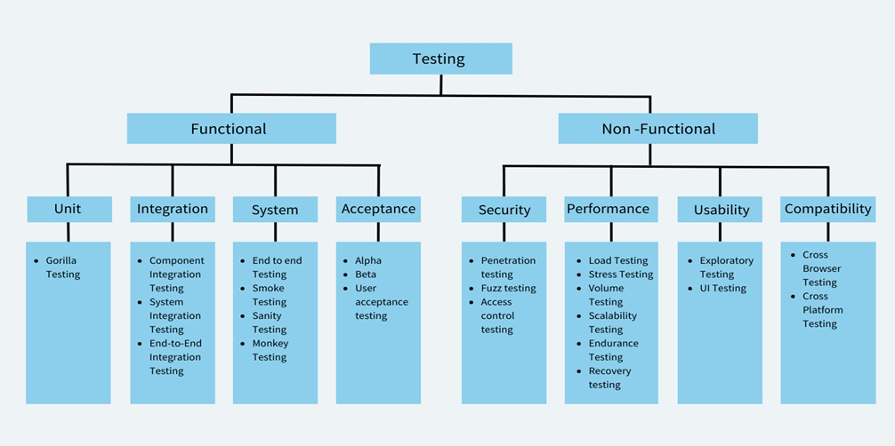

Slide 4
Unit Testing
Unit testing involves testing individual components or modules of a software application in isolation to ensure they function correctly.
Each unit, typically a function or method, is tested independently from the rest of the code.
A unit can be one method or multiple classes.
A unit test is an automated piece of code that invokes a unit of work in the system. And a unit of work can span a single method, a whole class or multiple classes working together to achieve one single logical purpose that can be verified.”
The goal is to identify issues at an early stage of development, such as logic errors or edge cases, before integrating the module with others.
Unit tests are often automated, providing fast feedback and improving code quality by ensuring that each part works as expected before moving to more complex testing stages.

Slide 5
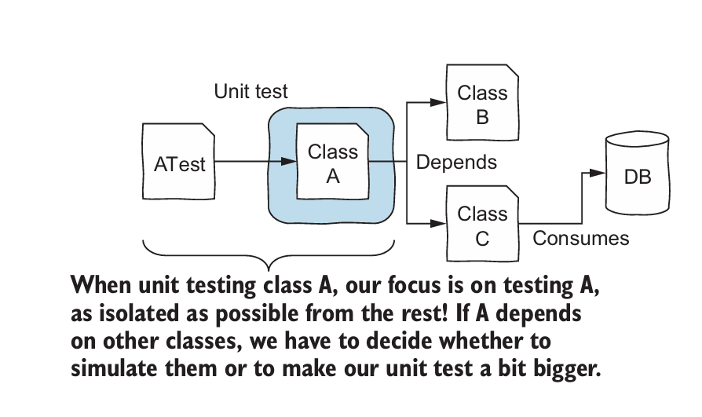
Unit Testing
Advantages
  Fast: A unit test usually takes just a couple of milliseconds to execute.
  Easy to control: A unit test tests the software by giving certain parameters to a method and then comparing the return value of this method to the expected result.
  Easy to write: They do not require a complicated setup or additional work. A single unit is also often cohesive and small, making the tester’s job easier.
Disadvantages
  Lack reality: A software system is rarely composed of a single class. Unit tests do not perfectly represent the real execution of a software system.
  Some types of bugs are not caught: Some types of bugs cannot be caught at the unit test level; they only happen in the integration of the different components

Slide 6
Types of Unit Testing
The two primary types of unit testing are:
Static Unit Testing (Non-Execution-Based): This involves analysing the code without actually executing it. Techniques like code inspections and walkthroughs are used to identify potential issues like coding standard violations, logic errors, or potential performance bottlenecks.
Dynamic Unit Testing (Execution-Based): This involves running the unit under test and observing its behavior. Common techniques include:
  Black-box Testing: Test cases are designed based on the unit's specifications and requirements without knowledge of the internal code
  White-box Testing: Test cases are designed based on knowledge of the unit's internal structure and code
  Control Flow Testing: Focuses on testing different paths through the unit's control flow, such as different branches of conditional statements or loops
  Data Flow Testing: Examines the flow of data through the unit, ensuring that variables are defined, used, and modified correctly

Slide 7
Test-Driven Development (TDD)
Test-driven development is a way of writing code that involves writing an automated unit-level test case that fails, then writing just enough code to make the test pass, then refactoring both the test code and the production code, then repeating with another new test case.
Tools for Unit Testing
A variety of tools support unit testing, including:
  Testing Frameworks: JUnit (for Java), NUnit (for .NET), pytest (for Python), and many others provide a structured way to write, execute, and analyze unit tests
  Mocking Frameworks: Mockito, EasyMock (for Java), and others help create mock objects or test doubles to simulate the behavior of external dependencies
  Code Coverage Tools: Measure the percentage of code executed during testing, helping ensure thoroughness

Slide 8
Integration Testing
Integration testing focuses on testing how different software modules work together after being integrated.
The goal of integration testing is to identify issues related to data flow, communication between modules, and overall functionality, ensuring that the system works seamlessly as a whole.
Compared to unit testing, integration tests are more difficult to write.
Why is Integration Testing Important?
  Detecting Interface Issues: Integration testing helps uncover defects in the interfaces between components, such as mismatched data types, incorrect assumptions about input or output formats, or communication errors.
  Validating Component Interactions: Integration testing verifies that components collaborate and communicate correctly to achieve the desired system functionality. For instance, it ensures that data flows correctly between components, events are triggered and handled properly.
  Uncovering Architectural Flaws: Integration testing can help reveal design flaws in the system architecture, such as dependencies between components that hinder testability or maintainability.

Slide 9
Integration Testing Techniques
Incremental Integration: Components are integrated and tested incrementally, a few at a time, building upon a stable and tested base. This approach provides early feedback and facilitates easier fault isolation.
Top-Down Integration: Testing starts with the highest-level modules in the system hierarchy, moving down through the layers. Stubs are used to simulate lower-level components until they are integrated. This technique emphasizes testing the user interface and overall system flow early.
Bottom-Up Integration: Testing starts with the lowest-level modules, building up to the higher levels. Drivers are used to simulate the calls to the lower-level components from higher levels. This approach focuses on testing individual component functionality first.
Sandwich/Hybrid Integration: A hybrid approach that combines elements of top-down and bottom-up integration. It aims to test critical subsystems early using both stubs and drivers. This technique offers flexibility but requires careful planning and coordination.
Big-Bang Integration: All components are integrated and tested at once. This is generally discouraged for complex systems, as it makes fault isolation and debugging extremely difficult.

Slide 10
System Integration Test (SIT) Plan
A well-defined SIT plan is essential for successful integration testing. Key elements of an SIT plan include:
  Scope of Testing: Clearly defining which components and subsystems will be integrated and tested in each phase.
  Integration Levels: Specifying the granularity of integration testing, whether it's intrasystem, intersystem or pairwise.
  Integration Techniques: Choosing the most appropriate technique (incremental, top-down, bottom-up, sandwich) for the specific project.
  Test Environment Setup: Describing the hardware, software, and network configuration needed to support integration testing.
  Entry and Exit Criteria: Defining clear criteria for when a particular phase of integration testing can begin (entry criteria) and when it's considered complete (exit criteria).
  Test Cases and Procedures: Documenting detailed test cases, including the steps to execute them, expected results, and how to analyze and interpret the outcomes.
  Defect Management: Establishing procedures for reporting, tracking, and resolving defects found during integration testing.

Slide 11
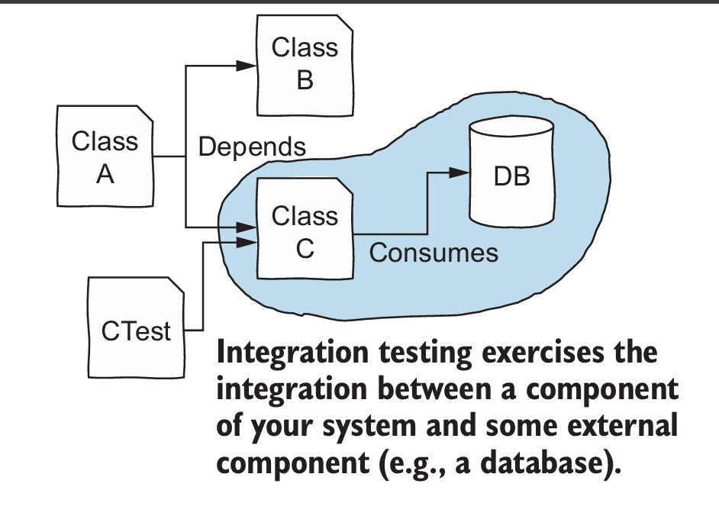
Challenges for Integration Testing
Managing Dependencies: Integrating components that rely on external systems or third-party libraries can introduce complexities and require the use of stubs or mocks.
Environment Setup: Creating and maintaining a realistic test environment that accurately represents the production environment can be challenging.
Test Data Management: Generating and managing test data that adequately covers the various interactions between components can be complex.

Slide 12
Functional Testing
Functional testing is a software testing technique that focuses on verifying the functionality of a software application. It involves testing the software against its specifications to ensure that it behaves as intended. It is mainly related to black-box testing because it does not consider the internal workings of the software.
Focus on Specifications: Test cases are derived from functional specifications, requirements documents, or user stories that describe the intended behavior of the software.
Black-Box Approach: Testers do not need to know the internal implementation details of the software. They treat it as a "black box," providing inputs and observing outputs to determine if it meets specifications.
Input-Output Behavior: Functional testing primarily focuses on validating the input-output behavior of the software. Testers provide a set of inputs and verify that the software produces the expected outputs.
Validation of Requirements: The main goal is to ensure that the software fulfills the requirements and specifications set forth by stakeholders and users.

Slide 13
Functional Testing Techniques
Equivalence Class Partitioning: Dividing the input data into groups or classes that are expected to be treated similarly by the software.
Boundary Value Analysis: Testing the software with values at the boundaries of input ranges and data types.
Decision Table Testing: Creating tables that represent different combinations of input conditions and expected outputs to ensure comprehensive testing of decision logic.
State Transition Testing: Creating test cases based on the different states of the software and the transitions between those states, especially relevant for systems with complex workflows or user interactions.
Use Case Testing: Designing test cases based on typical user scenarios and how they interact with the software.
Error Guessing: Using experience and intuition to anticipate potential errors and design test cases accordingly.

Slide 14
Benefits of Functional Testing
Ensures Correct Behavior
Verifies that the software behaves as intended and meets user expectations.
Early Defect Detection
Identifies defects early in the development lifecycle, reducing the cost and effort of fixing them later.
Improved Software Quality
Contributes to the overall quality and reliability of the software.
Reduced Risk Mitigates the risk of releasing software with critical defects.
Increased User Satisfaction
Leads to software that is more user-friendly and meets user needs.

Slide 15
Functional vs Structural Testing
Functional Testing (Black-box Testing) is often contrasted with Structural Testing (White-box Testing). Here are the key differences:
Focus: Functional testing focuses on the external behavior of the software, while structural testing focuses on the internal structure and implementation.
Knowledge Required: Functional testing doesn't require knowledge of the internal workings, while structural testing requires understanding of the code and algorithms.
Test Case Design: Functional test cases are derived from specifications, while structural test cases are based on code paths, data flow, and control flow.
Goal: Functional testing aims to validate requirements, while structural testing aims to ensure code coverage and identify implementation-specific defects.

Slide 16
Example of Functional Testing in Action
Let's consider a simple example of functional testing for a login authentication feature on a website. The functional specification might state that a user should be able to log in with a valid username and password, and an error message should be displayed for invalid credentials.
Functional Test Cases:
  Valid Credentials: Enter a valid username and password and verify successful login.
  Invalid Username: Enter an invalid username and a valid password and verify an error message.
  Invalid Password: Enter a valid username and an invalid password and verify an error message.
  Empty Username: Leave the username field empty and enter a valid password and verify an error message.
  Empty Password: Enter a valid username and leave the password field empty and verify an error message.
These test cases, while simple, effectively cover various scenarios and ensure that the login functionality behaves as expected.

Slide 17
System Testing
System testing is a crucial phase in software development where the entire integrated system is evaluated against its requirements to ensure it functions as intended.
It focuses on system-level properties and aims to uncover faults in the fully assembled system.
Importance of System Testing
  Verification Activity: It checks the consistency between the software system and its specification. This distinguishes it from acceptance testing, which focuses on validating user needs.
  Uncovering Faults: Like other testing levels, system testing aims to identify and fix defects, but with an emphasis on system-level behaviours rather than individual module functionality.
  Release Assessment: System testing, along with acceptance testing, plays a significant role in deciding if a product is ready for customer release.

Slide 18
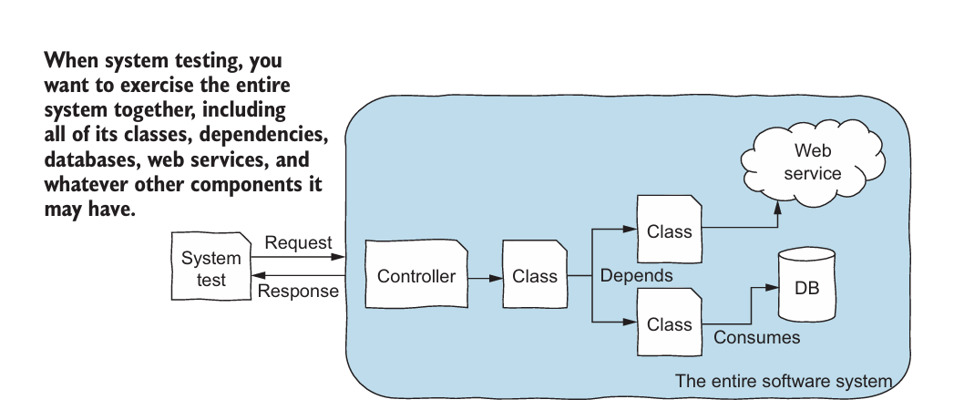
Characteristics of System Testing
Comprehensiveness: System testing aims to test the entire system based on its specifications, covering every specified behavior and feature.
Specification-Based: Tests are designed based on the system specification and observable behavior. This is also known as black-box testing, meaning the tester doesn't need knowledge of the internal code.
Independence: System testing should be independent of design and implementation decisions. This ensures a more objective evaluation focused solely on meeting the specifications.

Slide 19
Downsides of System Testing
System tests are often slow compared to unit tests. Imagine everything a system test has to do, including starting and running the entire system with all its components. The test also has to interact with the real application. This takes more time than running a simple unit test, which has virtually no dependencies.
System tests are also harder to write. Some of the components (such as databases) may require a complex setup before they can be used in a testing scenario. Think of connecting, authenticating, and making sure the database has all the data required by that test case. Additional code is required just to auto mate the tests.
System tests are more prone to flakiness. A flaky test presents erratic behavior: if you run it, it may pass or fail for the same configuration. Many uncertainties in a system test can lead to unexpected behavior.

Slide 20
Key Differences
Feature | Unit Test | Integration Test | System Test
Focus | Individual modules | How modules interact | The System as a whole
Test cases derived from | Module specifications | Architecture and design specifications | Requirements specification and behaviour
Visibility required | All the details of the code | Some details of the code, mainly Interfaces | No details of the code
Scaffolding required | Potentially complex, to simulate the activation environment (drivers), the modules called by the module under test (stubs), and test oracles | Depends on architecture and integration order. Modules and external resources are progressively integrated. | Simple, may require simulators or emulators for unavailable external systems

Slide 21
Acceptance Testing
Acceptance testing is a formal testing process conducted to determine whether a system satisfies its acceptance criteria, which are the criteria the system must satisfy to be accepted by the customer.
The customer generally reserves the right to refuse to take delivery of the product if the acceptance test cases do not pass. It helps the customer decide whether or not to accept the system.
Acceptance testing focuses on validating if the software is suitable for user needs.
Its primary goal is to validate the usefulness and satisfaction with the product, as opposed to system testing, which aims to uncover faults.
It is a validation activity focused on ensuring the product meets users' needs and expectations, even if those needs and expectations have changed since the initial requirements were defined.

Slide 22
Types of Acceptance Testing
There are two categories of acceptance testing:
User acceptance testing (UAT) is conducted by the customer to ensure the system satisfies the contractual acceptance criteria before being signed off as meeting user needs. Often, third-party consulting firms are hired to plan and execute the acceptance tests, but the customer must specify the acceptance criteria.
Business acceptance testing (BAT) is performed within the supplier's development organization to ensure the system will eventually pass the UAT. It can be thought of as a rehearsal of the UAT, performed at the supplier's premises.
Acceptance Test Execution
Acceptance tests are typically executed in two phases:
  1. Basic tests: Executed first, these tests cover fundamental system functions. If a significant number fail, further testing may be unnecessary.
  2. Complex tests: Performed if the basic tests are successful, these cover more intricate system features and functionalities.

Slide 23
Acceptance Test Plan (ATP)
Planning for acceptance testing should begin as soon as the acceptance criteria are known. Early development of an acceptance test plan (ATP) allows for the visualization of the final product and can be delivered by the vendor as a contractual agreement.
Acceptance criteria are the set of conditions the system must meet in order to be acceptable to the customer. The criteria should be measurable and, preferably, quantifiable.
There are five views of quality that must be considered when defining acceptance criteria:
  Transcendental view: Quality is something that can be recognized but not defined
  User view: Quality is defined as "fitness for purpose," meaning the product does what the user needs it to do
  Manufacturing view: Quality is defined as conformance to specification
  Product view: Quality is tied to inherent product characteristics
  Value-based view: Quality depends on the amount a customer is willing to pay for it

Slide 24
Acceptance Criteria
Some examples of specific acceptance criteria include:
  Functional Correctness: Does the system function according to specifications?
  Accuracy: Does the system provide correct results?
  Data Integrity: Is data protected from unauthorized access and modification?
  Performance: Does the system meet performance requirements, such as response time and throughput?
  Reliability: How often does the system fail?
  Usability: How easy is the system to learn and use?
  Security: How well is the system protected from unauthorized access and malicious attacks?
  Maintainability: How easy is the system to maintain and update?
  Portability: Can the system be easily moved to different platforms or environments?

Slide 25
System Testing vs Acceptance Testing
Distinct Purposes: System testing is a verification activity, focused on ensuring the software meets its specifications. Acceptance testing is a validation activity, focused on ensuring the software meets user needs and expectations, even if those needs have changed.
Different Audiences: System testing is primarily conducted by the development team, while acceptance testing involves the customer.
Sequential Process: System testing typically precedes acceptance testing.
By employing a systematic and comprehensive approach to system testing, software development teams can increase the likelihood of delivering a high-quality product that meets customer expectations.

Slide 26
Automated Testing
While various testing activities require human expertise and judgment, many aspects of testing can be automated, allowing teams to focus their efforts on more complex and creative tasks.
Efficiency and Cost: Automating the repetitive and mechanical tasks of testing, such as maintaining test scripts, re-running tests, and comparing results, can significantly reduce the cost and human error associated with software testing.
Prerequisite for Agile Methods: Test automation is considered a prerequisite for agile development methodologies, especially test-driven development (TDD).
Addressing Specific Needs: Different types of automated tests address specific needs. For instance, tools like Selenium help automate web application testing, while JUnit and similar frameworks are commonly used for unit and integration testing.
Not All Tests Are Automatable: Some types of tests are inherently difficult or impossible to automate. For example, testing aspects like usability, interoperability, and robustness often relies on subjective human evaluation.

Slide 27
Need for Automating Tests
Load tests: What happens when 200 people try to use your software at the same time? What about 2000? You’ll need automation to simulate these scenarios.
Performance benchmarks: Is system performance getting better or worse? You can instrument automated tests to capture time measurements each time you run them. By collecting these measurements and reviewing them as a time series, you can detect performance degradations.
Configuration testing: Software often must work on different platforms, in different configurations, attached to different peripherals. How do you cover them all? Automation helps you increase your coverage.
Endurance testing: What will happen when your product has been in use for weeks or months? Memory leaks, stack corruption, wild pointers, and similar errors may not be apparent when they occur but will eventually cause trouble.
Race conditions: Some problems occur only in specific timing situations. The coincidental timing of two threads or processes contending for the same resource results in an error known as a race condition. These are often hard to find and hard to reproduce.

Slide 28
Regression Testing
Regression testing ensures that software modifications, such as bug fixes or new features, don't introduce new defects or regressions.
After any code change, relevant tests from previous stages are re-run to verify that existing functionalities remain intact.
Retest All: This straightforward approach involves re-executing all test cases from previous versions. While comprehensive, it can be time-consuming and resource-intensive, especially for large systems
Different development methodologies, such as Agile and Waterfall, have specific implications for regression testing:
  Frequent releases and continuous integration in Agile necessitate a robust regression testing strategy.
  Regression testing typically occurs at specific stages in Waterfall, such as after integration or before release.

Slide 29
Performance Testing
Performance testing evaluates a system's performance attributes under various conditions.
Performance Tests: Measure system characteristics like throughput and response time under normal and peak load conditions.
Scalability Tests: Determine the system's scaling limits regarding users, geographic locations, and resources.
Stress Tests: Push the system to its limits using high loads, resource constraints, or invalid inputs to uncover breaking points and failure modes.
Load and Stability Tests: Evaluate the system's ability to handle sustained loads over prolonged periods, verifying its stability and reliability.
Reliability Tests: Utilize statistical methods to assess the system's reliability, predicting failure rates and mean time to failure.

Slide 30
Other types of Software Testing
Security Testing: Aims to identify vulnerabilities and weaknesses that could be exploited by attackers, ensuring data confidentiality, integrity, and availability.
Usability Testing: Focuses on evaluating the user interface and overall user experience, verifying its intuitiveness, ease of use, and effectiveness in meeting user needs. This often involves real users interacting with the system and providing feedback.
Documentation Testing: Checks the accuracy, completeness, and clarity of user manuals, installation guides, API references, and other documentation.
Regulatory Testing: Ensures that the software complies with relevant industry standards, regulations, and legal requirements. Examples include safety regulations for medical devices or data privacy regulations, payment processing compliance.

Slide 31
Five-fold Testing System
Any testing that you do can be described in terms of five dimensions:
Testers: Who does the testing. For example, user testing is focused on testing by members of your target market, people who would normally use the product.
Coverage: What gets tested. For example, in function testing, you test every function.
Potential problems: Why you’re testing (what risk you’re testing for). For example, testing for extreme value errors.
Activities: How you test. For example: exploratory testing.
Evaluation: How to tell whether the test passed or failed. For example, comparison to a known good result.
All testing involves all five dimensions. A testing technique focuses your attention on one or a few dimensions, leaving the others open to your judgment. Testing tasks are often assigned on one dimension, but you do the work in all five dimensions.
Notes:
Testing tasks are often assigned on one dimension, but you do the work in all five dimensions. For example:
- Someone might ask you to do function testing (thoroughly test every function). This tells you what to test. You still have to decide who does the testing, what types of bugs you’re looking for, how to test each function, and how to decide whether the program passed or failed.
- Someone might ask you to do extreme-value testing (test for error handling when you enter extreme values into a variable). This tells you what types of problems to look for. You still have to decide who will do the testing, which variables to test, how to test them, and how you’ll evaluate the results.

Slide 32
People-Based Techniques
Here are some common techniques that are distinguished by who does them (Tester):
  User testing: Testing with the types of people who typically would use your product. User testing might be done at any time during development, at your site or at theirs, in carefully directed exercises or at the user’s discretion.
  Alpha testing: In-house testing performed by the test team (and possibly other interested, friendly insiders).
  Beta testing: A type of user testing that uses testers who aren’t part of your organization and who are members of your product’s target market. The product under test is typically very close to completion. There are actually many different types of beta tests: Design Beta, Marketing Beta, Compatibility Test Beta.
  Bug bashes: In-house testing using secretaries, programmers, marketers, and anyone who is available. A typical bug-bash lasts a half-day and is done when the software is close to being ready to release.
  Subject-matter expert testing: Give the product to an expert on some issues addressed by the software and request feedback (bugs, criticisms, and compliments).
Notes:
Focus on who does the testing

Slide 33
Coverage-Based Techniques
  Function testing: Test every function, one by one. Test the function thoroughly, to the extent that you can say with confidence that the function works.
  Feature or function integration testing: Test several functions together, to see how they work together.
  Menu tour: Walk through all of the menus and dialogs in a GUI product, taking every available choice.
  Domain testing: A domain is a (mathematical) set that includes all possible values of a variable of a function. In domain testing, you identify the functions and the variables. The variables might be input or output variables.
  Equivalence class analysis: An equivalence class is a set of values for a variable that you consider equivalent.
  Boundary testing: Test the boundary values of nearby classes that are just smaller than the smallest member of the class you’re testing and just larger than the largest member of the class you’re testing.
  Input field test catalogs or matrices: For each type of input field, you can develop a fairly standard set of test cases and reuse it for similar fields in this product and later products.
  Logic testing: attempts to check every logical relationship in the program. Cause-effect graphing is a technique for designing an extensive set of logic-based tests.
  State-based Testing: you walk the program through a large set of state transitions (state changes) and check the results carefully, every time.
Notes:
Focus on what gets tested

Slide 34
Activity-Based Techniques
  Regression testing. involves reuse of the same tests, so you can retest (with these) after change. There are three kinds of regression testing: bug fix regression, old bugs regression, and side-effect regression (stability regression). Think of cases where these would appear?
  Scripted testing: Manual testing, typically done by a junior tester who follows a step-by-step procedure written by a more senior tester.
  Smoke testing: This type of side-effect regression testing is done with the goal of proving that a new build is not worth testing.
  Exploratory testing: We expect the tester to learn, throughout the project, about the product, its market, its risks, and the ways in which it has failed previous tests.
  Guerilla testing: A fast and vicious attack on the program. A form of exploratory testing that is usually time-boxed and done by an experienced exploratory tester.
  Installation testing: Install the software in the various ways and on the various types of systems that it can be installed.
  Load testing: The program or system under test is attacked, by being run on a system that is facing many demands for resources.
  Performance testing. These tests are usually run to determine how quickly the program runs, in order to decide whether optimization is needed.
Notes:
Focus on how you test

Slide 35
Evaluation-Based Techniques
Focus on how to tell whether the test passed or failed.
Self-verifying data: The data files you use in testing carry information that lets you determine whether the output data is corrupt.
Comparison with saved results: Regression testing (typically, but not always automated) in which pass or fail is determined by comparing the results you got today with the results from last week.
Comparison with a specification or other authoritative document: A mismatch with the specification is (probably) an error.
Oracle-based testing: An oracle is an evaluation tool that will tell you whether the program has passed or failed a test. In high-volume automated testing, the oracle is probably another program that generates results or checks the software under test’s results.

Slide 36
Case Study 1: E-commerce Application
Unit Testing
Each component, such as the product search function and user login authentication, is tested individually to ensure they work as expected. Unit tests verify that each feature handles inputs and outputs correctly, isolating logic errors early.
Integration Testing
Integration testing validates interactions between modules, such as how the payment processing module interacts with the inventory management system. This ensures that different components work together seamlessly, handling data flow and error states correctly.
System Testing
System testing evaluates the entire application’s functionality in a real environment, covering the full user journey from browsing products to checkout. It examines the app’s overall behavior, including navigation, data consistency, and security protocols.

Slide 37
Case Study 1: E-commerce Application (cont’d)
Acceptance Testing - Acceptance testing ensures the system meets the business requirements and user needs. Here, stakeholders test scenarios such as adding items to the cart, proceeding through checkout, and applying discount codes to confirm they match the desired experience.
Performance Testing - Performance tests assess the system’s behavior under load, like handling a high number of users during a flash sale. Tests such as load and stress testing identify response times, server capacity, and system resilience under peak traffic.
Security Testing - Security testing checks for vulnerabilities like SQL injection in search fields and data privacy for user credentials. This is crucial for protecting sensitive customer information, including payment details and personal information.
Regression Testing - After updates or new features (e.g., adding a new product category), regression testing ensures that existing functionalities, such as product browsing or user registration, are not impacted by the changes.

